Slide 1
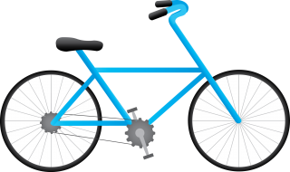
Cool Bikes App
Agenda:
Introduction
Structure
Demonstration
Q&A

Slide 2
Introduction
This project consists in a simple ERP system for a bike shop.
We will be able to manage sales, stocks and users.
The app is coded in python, emphasising the use of “Tkinter” and “Sqlite3” libraries.

Slide 3
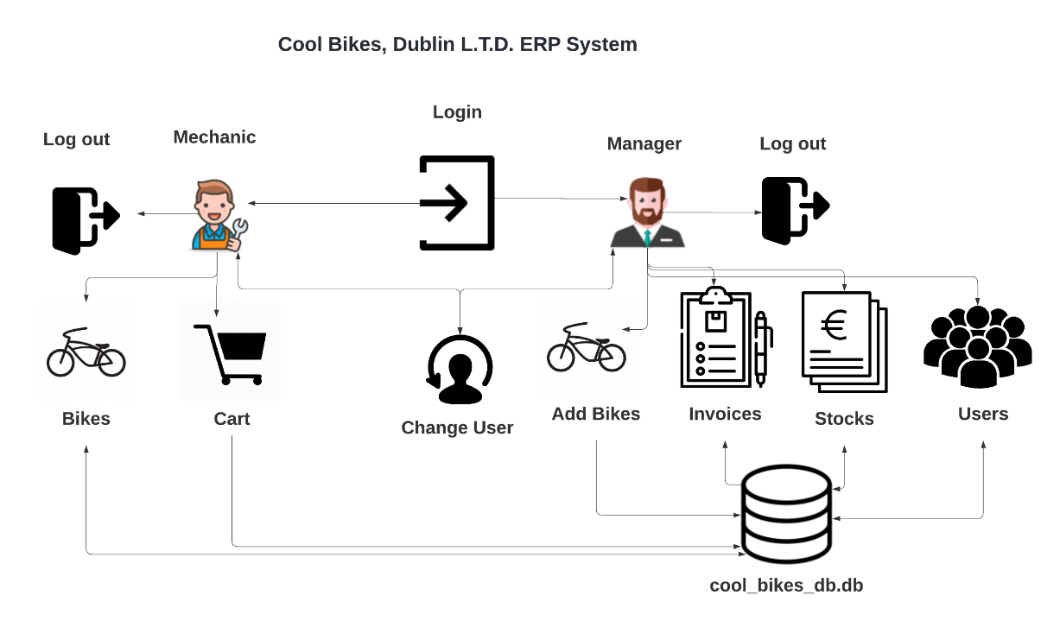
Introduction
Project Map:
Fig.1: High level project map.

Slide 4
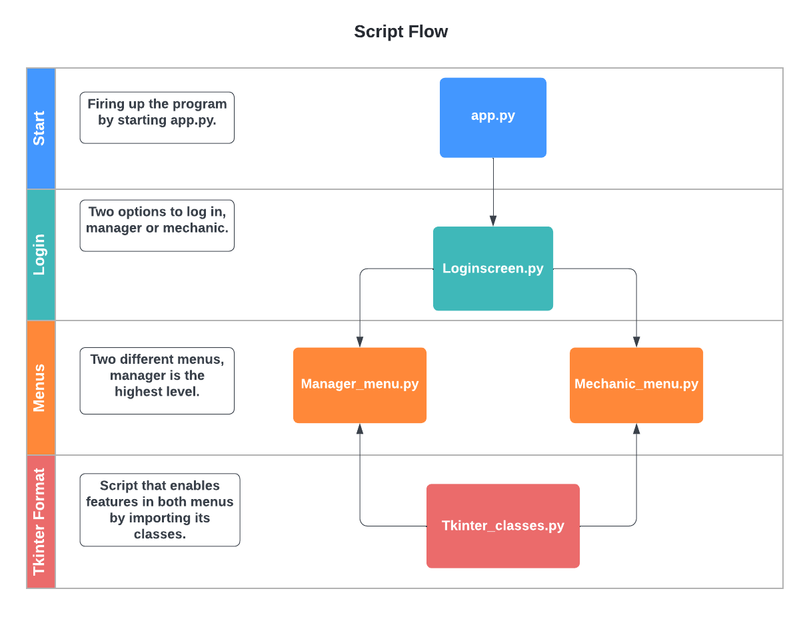
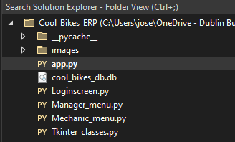
Structure
Five scripts compose this app:
Fig.1: High level project map.

Slide 5
Demonstration
Time to run the app.
Fig.1: High level project map.

Slide 6
Q&A
How I must submit the app??
Fig.1: High level project map.

